Slide 1
MBS Xojo Developer Conference

Slide 2
Creating Custom Controls in Xojo
Jeremie LEROY
Notes:
Hi everybody, I am Jeremie Leroy from Paris in France.
Since I started working with Xojo, formerly call RealBasic back in 2009, I have specialized in UI design and Custom Controls.
(click) I would like to share with all of you some of knowledge about Creating Custom Controls in Xojo.

Slide 3
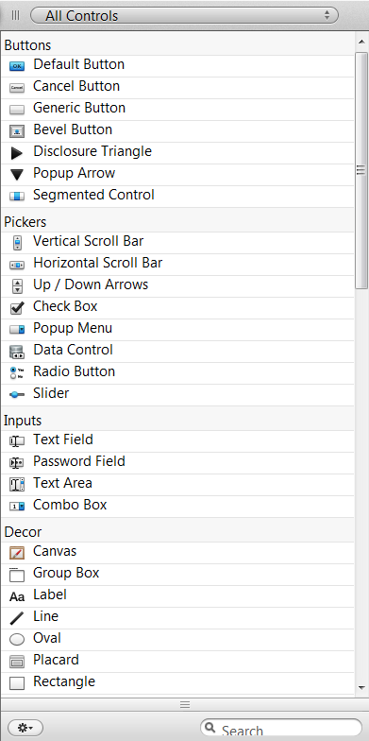
Why use Custom Controls ?
Xojo has more than 30 controls
Organize your window differently
Change the look & feel of your application
Create a more efficient application
Notes:
First of all, why use Custom controls ?
(click) Xojo comes with more than 30 built-in controls
Such as Buttons, Checkbox, Sliders, Textfields, Labels and so on.
To make a simple application it is more than enough to use these controls.
But you will see that Custom Controls can bring a lot more to your application.
(click) Organize your window differently, we will see an example about this later on
(click) Change the look & feel of your application

Slide 4
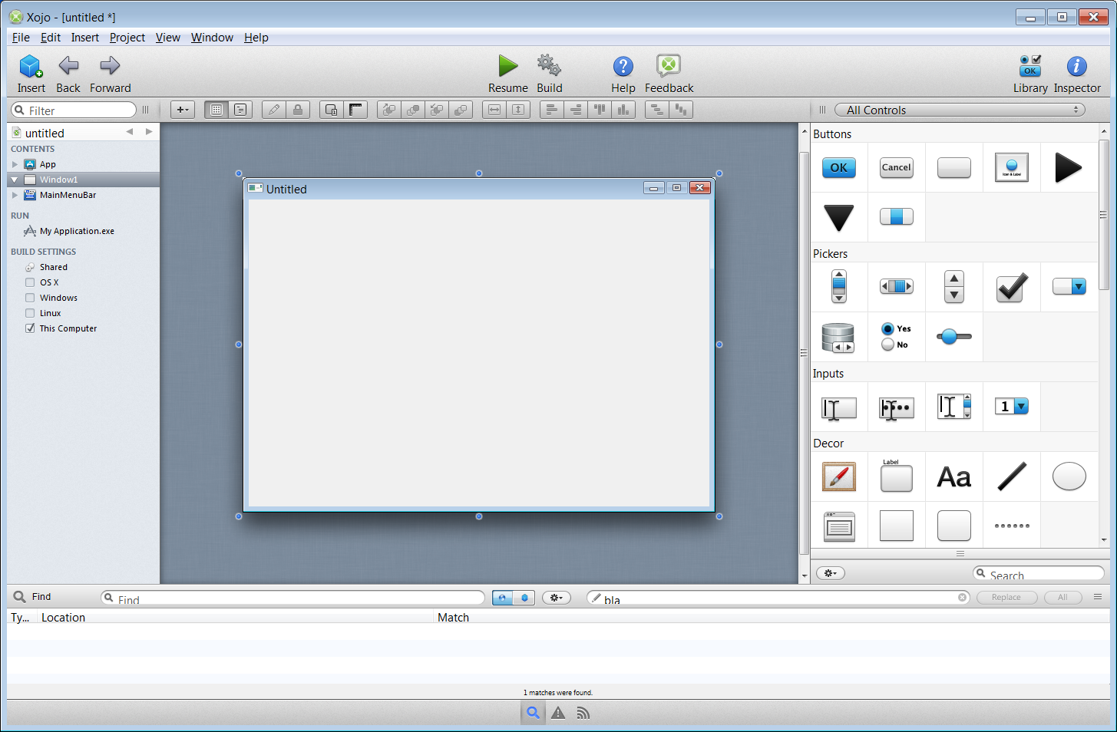
Custom Controls in Xojo
11 controls on this picture
More than 17 custom controls overall
Xojo has a unique look & feel
Impossible without custom controls
Notes:
Lets take a look at Xojo.
How many custom controls can you see here ?
1, 2, 5 maybe ?
Well, lets check…
(click)
There are at least 11 custom controls here
The main Toolbar
The design toolbar
The Treeview on the left that shows all contents of your project
The Library on the right
And even the Window editor.
(click)
Overall in Xojo, I have counted at least 17 custom controls.
For those of you that were using RealStudio before Xojo, you certainly saw that the IDE was completely redesigned.
(click)
Xojo now has a real visual identity. I am sure most of you can recognize Xojo from other apps at a quick glance.
Creating this unique identity is only possible by using custom controls.

Slide 5
Creating Custom Buttons - First steps
Use a Canvas
Inspector behavior
Width: 60
Height: 60
UseFocusRing: False
EraseBackground: False
DoubleBuffer: False
Notes:
We are now going to see how to create simple buttons like these. (click)
Although they look simple, they can give your Application a fresh and enjoyable look.
In an application it is often better to use pictures on a button for obvious actions. They eye will recognize a picture much faster than some text.
(click)
To create a custom button, the first thing (click) is to use a Canvas
Now lets open Xojo (click on Xojo)
Create a new Class called RoundButton
Directly edit the Inspector behavior with the following settings (click)
Now we add some pictures to the project and start coding.

Slide 6
Creating Custom Buttons - Enhancing Refresh
Notes:
When refreshing, the pictures sort of looses its transparency and the border becomes black.
This is because we use the Refresh(False) function.
To prevent this, we will implement our own Double Buffer system.

Slide 7
Notes:
Continue coding in Xojo

Slide 8
Questions ?

Slide 9
Thank you all for your attention
www.JeremieLeroy.com
Notes:
Thank you all for your attention

